Slide 1

A
PRESENTATION
ON
“Sarkari Yojana Android App”
SUBMITTED BY
Neha Dhanorkar
Harshada Dagale
Anisha Deshmukh
Kirti Chavan
UNDER THE GUIDANCE OF
PROF. R.C. MAHAJAN
DEPARTMENT OF COMPUTER ENGINEERING
SANDIP POLYTECHNIC, NASHIK
(2023-2024)

Slide 2
1
Sarkari Yojana Android App
Government Schemes
Sandip polytechnic, Nashik

Slide 3
Contents:
Introduction
Existing system
Drawbacks of Existing System
Proposed System
Block Diagram
Data Flow Diagram
Requirement Analysis
Advantages
Applications
Future Scope
Conclusion
Sandip polytechnic, Nashik

Slide 4
Introduction:
There are many useful government schemes and policies run by state and central government in India.
The Government of India launches different usable schemes from time regularly.
The purpose of such government policies are to empower the special class of people and provide motivation in order to achieve life standards.
The actual aim of the project has been to provide different useful information that fulfill their need and support financially to overcome gap between rich and poor people.
Sandip polytechnic, Nashik

Slide 5
Existing system:
Existing system is a manual one in every panchayat displays the list of available schemes provided by the Government.
It invites the applications from the eligible users based on certain criteria.
All the applications are verified at panchayat level and then approved applications are sent to District level for approval.
All the approved users avail the benefits of the scheme.
Sandip polytechnic, Nashik

Slide 6
Drawbacks of existing system:
Lack of Interactivity
Not Trustworthy
Security Concerns
Privacy Concerns
Ineffective Feedback Mechanisms
Technical Issues

Slide 7
Proposed system:
The proposed system of Government scheme android application there are basically two modules mainly Admin module and User module.
Admin have rights to add government policies in application under different categories.
In user module user can access information of different government policies under different categories in PDF format.
Proposed system is a software application which avoids more manual hours that need to spend in record keeping and generating reports.
This application keeps the data in a centralized way which is available to all the users simultaneously.
Sandip polytechnic, Nashik

Slide 8
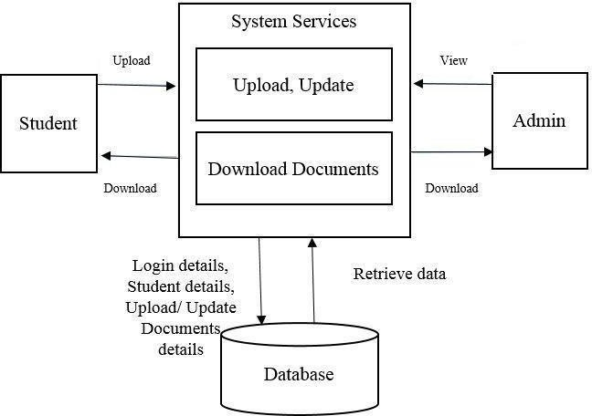
Block Diagram:
USER
Sandip polytechnic, Nashik

Slide 9
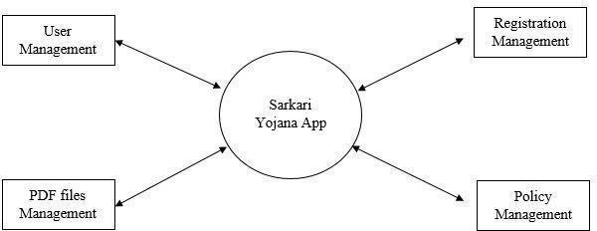
Data Flow Diagram:- DFD – level 0 :
Sandip polytechnic, Nashik

Slide 10
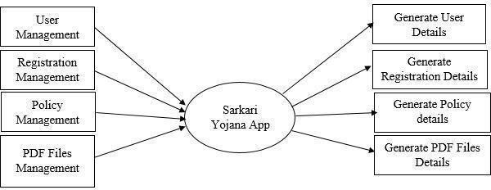
Data Flow Diagram:- DFD – level 1 :
Sandip polytechnic, Nashik

Slide 11
WHAT WE DID SO FAR:-
First there was selection of three topics on which we wanted to do presentation. They are:
Food and cloths donation website, Online voting System, Government Schemes- Sarkari Yojana Android App
Finalised the topic, Search on the topic & and collecting the information. Studying about the existing system.
Then we have new ideas for that, means what are features add in our system. Working on the gathered requirements
Submitted the abstract and Synopsis.Study about the additional requirements for the implementation of project.
Finalizing the work flow module of the proposed system. Searching & Finalizing the platform and all relevant information for the proposed system Gathering & Integrating all information gathered 5th Semester Project Report Writing .
After that, now the final presentation.
Sandip polytechnic, Nashik

Slide 12
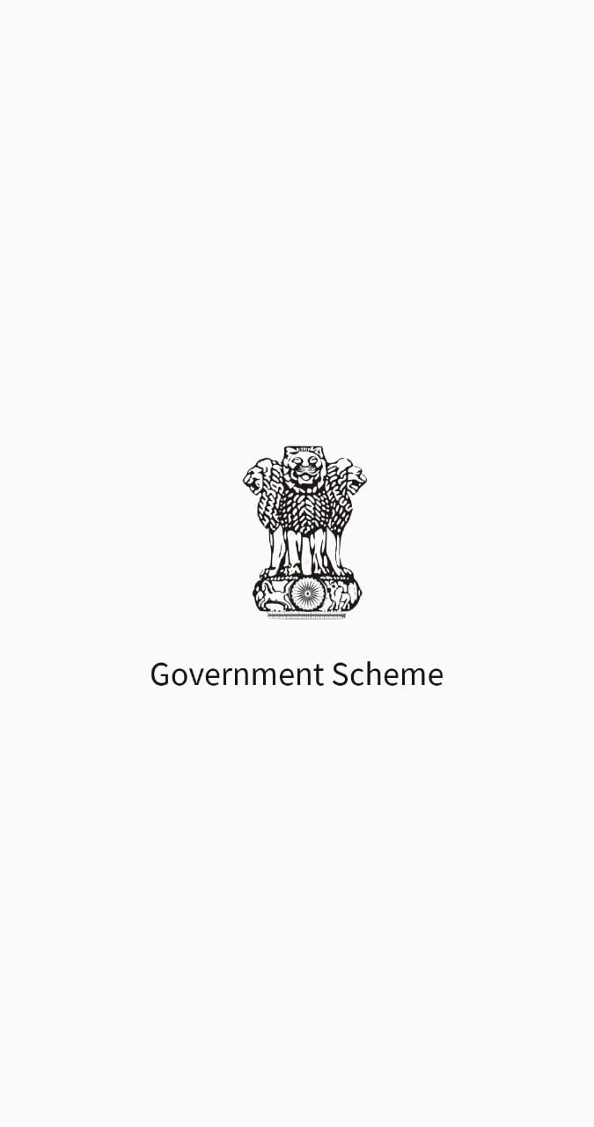
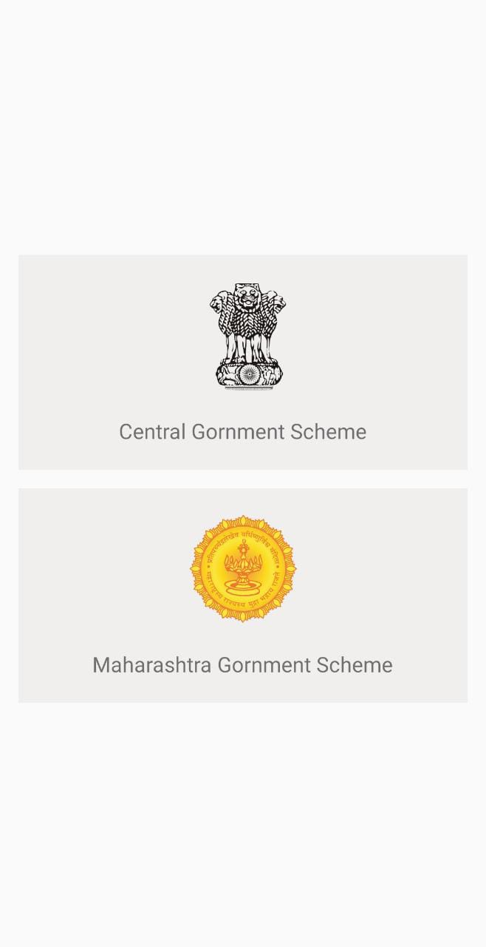
OUR WORK

Slide 13
Requirement Analysis:
Hardware Requirements | Software Requirements | Connectivity Requirements
Device: Desktop Computer, Laptop, Tablet, or Smartphone. | Operating System: Windows 7 Front End: Android Studio Back End: Fire base. | Internet Connection: Users need a reliable internet connection to access the application. While a broadband or high-speed connection is ideal.
Processor : Intel core i3 Ram: 4 GB (min) Hard disk : 64GB | Browser Extensions: Users should not be required to install any specific browser extensions or plugins to access your website. Keep the website functionality self-contained within the browser.
Sandip polytechnic, Nashik

Slide 14
Advantages:
This system will reduce the paper work
Any government policies can be access within single click it used to takes a lot of time in existing system
Government policies can reach up to major population in short duration
Any illegal practices or corruption can be prevented
This application is useful for implementing government policies effectively
Sandip polytechnic, Nashik

Slide 15
Applications:
This system can be used by state or central authority to publish different government policies
This system is mainly useful for common people who want take benefit of these policies.
Sandip polytechnic, Nashik

Slide 16
Future Scope:
Sarkari Yojana app also keep update about latest government policies from government hence it prevents any illegal practice about these scheme.
Major population uses android phones hence these government policies can reach to large population which was not possible in existing system. So this app helps to increase reach of these policies.
Government can implement these policies in effective way. As this app can be able to view or download PDF files of schemes under specific category. But we can also add some features in this app.
Sandip polytechnic, Nashik

Slide 17
Conclusion:
The Government scheme App is implemented for common people which are away from these policies because of lack of knowledge.
It is easy to sort out scheme information as compare to manual process.
It provides better delivery of government services to rural area and beneficiaries can get different ideas related to government schemes within the time.
Due to lack of knowledge some people take disadvantages of poor people and take charges for implementing such policies which is illegal.
Often many people who need such kind of help were unable to access it simply because they didn’t hear about it.
Sandip polytechnic, Nashik

Slide 18
1
Thank you
Sandip polytechnic, Nashik

